Slide 1
Estimation Problems
How many leaves are on a fully bloomed 3 foot tree?
branches
leaves
leaves
100 ≤ # of leaves ≤ 500
10
×
30 = 300
tree
branch
tree
1 ≤ # of leaves ≤ 5000
Notes:
Thank everyone both in person and online for joining. I recently attended a math conference where Jane Street, a quantitative trading firm, held something called an Estimathon. And I had so much fun that I decided to host one here. During an Estimathon you will be answering estimation questions. These problems are sometimes called Fermi problems, named after physicist Enrico Fermi, because he was renowned for his ability to make quick estimations with very little information, often using simple mental calculations. One famous question is “how many licks does it take to get to the center of a Tootsie Roll pop?”. Or How much does a cloud weigh? So why do we care about these questions? Well, this is the Data Summit, and Fermi questions are great tools for encouraging critical thinking and estimation skills in the face of uncertainty. They encourage us to break down complex problems into manageable components and apply mathematical reasoning to real-world scenarios, which is an essential skill when working with data. These types of questions urge us to explore and validate our assumptions, and ultimately helping us make more informed decisions based on data. So I want to really briefly walk through the thought process of answering one of these questions like “how many leaves are on a fully bloomed 3 foot tree?” This isn’t a very well defined problem nor does it have an exact answer. One might think, why does it matter that the tree is fully bloomed? Well in the winter there are likely zero leaves, which makes the estimation question a little less fun. So next we may think, maybe because the tree is small we can assume it doesn’t have a lot branches. Think of those small trees they have at Costco. Let’s say maybe 10 branches per tree. And again, because it is a small tree, maybe there aren’t a lot of leaves. A *bush* might have lots of tiny leaves but a tree should have less, right? Let’s just say 30 leaves per branch. If we multiply those numbers together we can get an estimate for the number of leaves on the tree. Now, while this estimate gives us a specific number, we recognize there's some room for error because not every tree will fit this exact pattern. Some branches might have less leaves, and others might have more. Therefore, it’s often useful to provide a range—like 100 to 500 leaves—that captures our uncertainty and reflects both the lower and upper bounds of our estimate. This range is more precise than a broad range like 1 to 5000, which, while accurate, doesn’t help us much in understanding what’s more likely. So the point is, making educated guesses and providing ranges is all part of the fun with estimation! So this is the kind of mentality you should have going into this game.

Slide 2
Estimathon Overview
30 minutes to work on 13 estimation problems
How many days are in a week?
Exact answers are always positive Exact Answer = 7
Estimations are submitted as intervals. Good intervals help you win: good interval = [2, 9] (contains answer and is positive) bad interval = [1, 2] (does not contain answer) bad interval = [-5, 10] (has negative and zero)
Lower Bound
Upper Bound
Notes:
Now that we know what an estimation problem is, the main idea of an estimathon is that it is a speed round where teams will have 30 minutes to work on 13 estimation problems. To make the game a bit more fun and to help with grading, we will also be considering trivia questions and the estimation problems I did pick do all have exact answers. Just to illustrate how this would work, consider a very simple question like how many days are in a week? Now of course the questions will be a bit harder than this, but this is just for illustrating the rules. The answers to these problems you will be working on will always be positive, like for our sample question the answer is 7. Estimations are going to be submitted as intervals. An interval is another way of describing a range that has both a lower bound and an upper bound. Good intervals help you win:
For example, a good interval for this problem would be 2 as the lower bound and 9 as the upper bound because it contains the answer and all the values are positive. A bad interval might be 1 to 2 because it does not contain the answer or another bad one would be -5 to 10 because this interval contains negative numbers and zero, which are not possibilities for the answer.

Slide 3
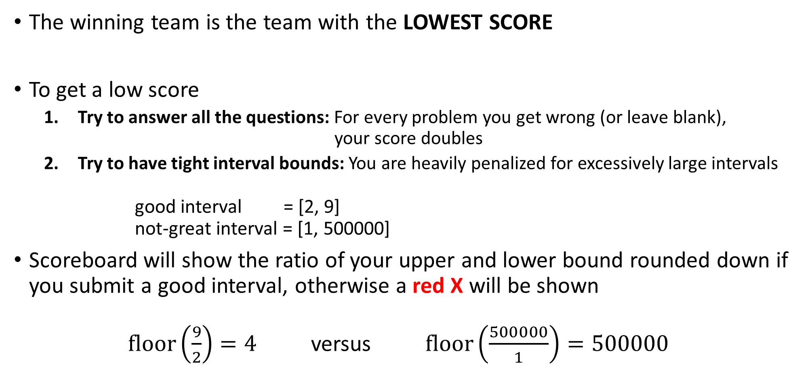
Scoring
The winning team is the team with the LOWEST SCORE
To get a low score
Try to answer all the questions: For every problem you get wrong (or leave blank), your score doubles
Try to have tight interval bounds: You are heavily penalized for excessively large intervals good interval = [2, 9] not-great interval = [1, 500000]
Scoreboard will show the ratio of your upper and lower bound rounded down if you submit a good interval, otherwise a red X will be shown $\text{floor}\left(\frac{9}{2}\right)=4$ versus $\text{floor}\left(\frac{500000}{1}\right)=500000$
Gives lower score
Gives higher score
Notes:
How does scoring work. I’m not going to go over the scoring function in detail as that is in the detailed rules on your table. Like with golf, the winning teams has the lowest score. To get a low score you should do two things. First, try to answer all of the questions because every problem you get wrong or leave blank, your score doubles. Second, you should try to have tight interval bounds. What that means is that you will be penalized heavily for excessively large intervals. For example, in our days of the week question, a good interval would be 2 to 7 because it is narrow and contains the answer and a not great interval would be 1 to 500000 because it is very wide but it does contain the answer. The scoreboard will show the ratio of your upper and lower bound rounded down if you a submit a good interval, otherwise a red X will be shown. In the two intervals I gave earlier, the 2 to 9 interval would show a 4 on the scoreboard and the 1 to 500000 would should a 500000 on the scoreboard. The narrower interval will give a lower score as opposed to the wider interval.

Slide 4
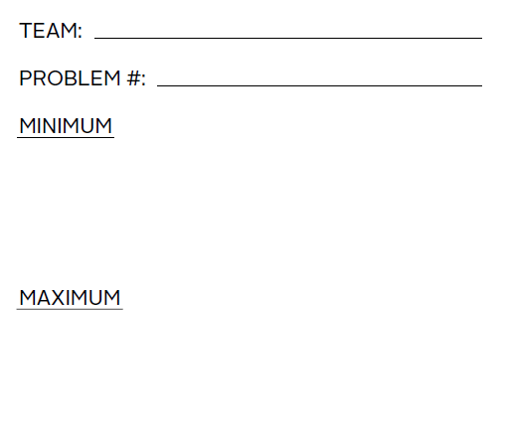
Submitting Answers
Every team can submit up to 18 intervals in total
Submit at any time
Each slip must contain your team name, problem number, and interval (lower bound and upper bound)
Hand it to the correct person (if applicable)
Notes:
Next we’ll talk about submitting answers. This is partially for the people participating in person, and I’ll give some more guidance separately about the people participating virtually in a little bit. Every team can submit 18 intervals in total. You can submit at any time. Just run up to the table where the friendly people waving are sitting. Each slip must contain your team name, problem number and the interval which includes both the lower bound (listed here as the minimum) and the upper bound (listed here as the maximum). Just make sure you hand the slip to the correct person (as some people may be only grading certain problems).

Slide 5
Re-Submitting
You may submit intervals more than once
Only the last submission for any given problem is the one that will count towards your final score
Multiple wrong submissions will be marked as multiple red X’s on the scoreboard
Multiple X’s doesn’t affect a team’s score—it counts as one X
Notes:
Now on the topic of resubmitting. There are 13 problems and 18 answer slips, so that means you can submit answers more than once. But be CAREFUL! Only the last submission for a problem will count towards your final score. This means it is possible to submitting a wrong answer to a problem and that will overwrite a previously submitted good answer to a problem. We don’t pick the best of all your submissions. So there is a risk reward consideration here. Multiple wrong submissions will be marked as multiple red X’s on the scoreboard. And Multiple X’s doesn’t affect a team’s score, it’s just so you know the answer has been graded.

Slide 6
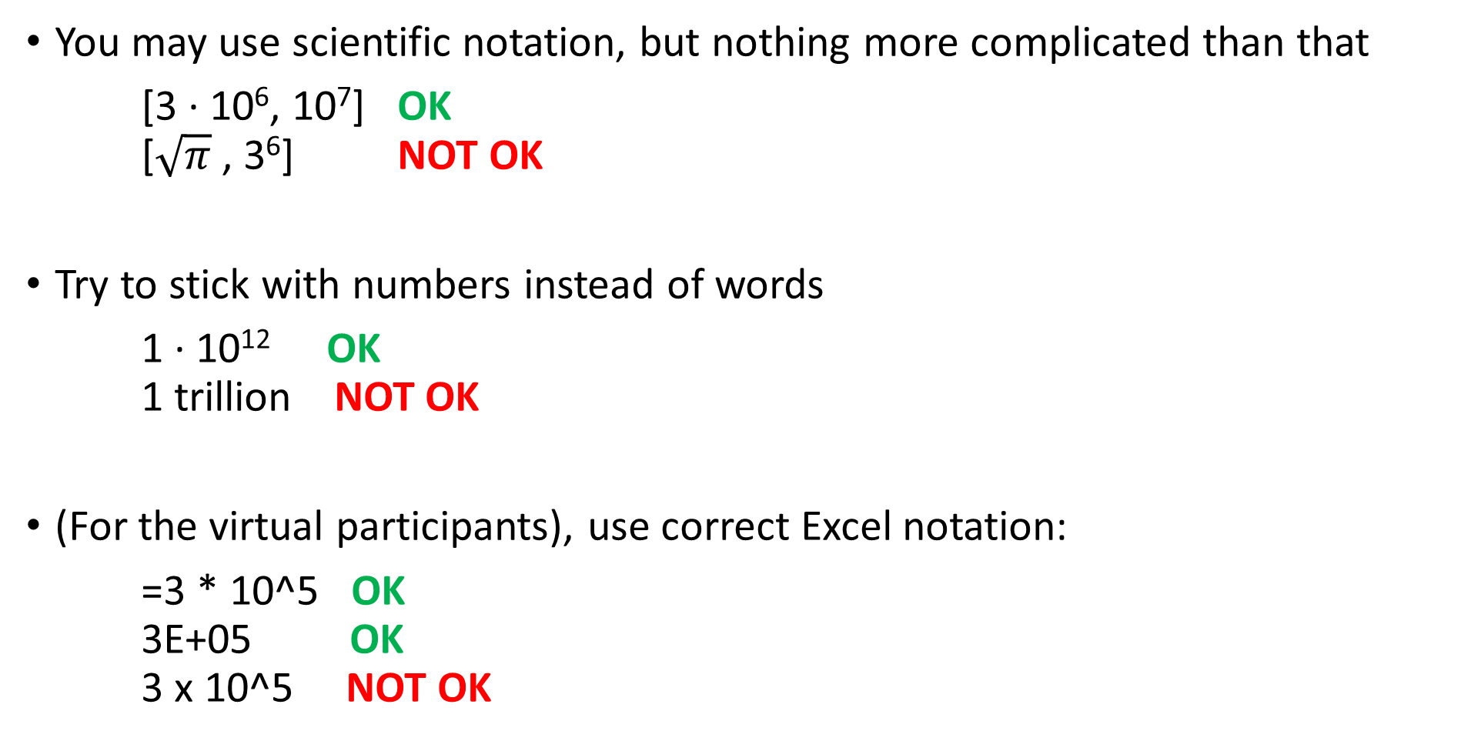
Notation
You may use scientific notation, but nothing more complicated than that
[3 · 10⁶, 10⁷] OK [$\sqrt{π}$, 3⁶] NOT OK
Try to stick with numbers instead of words
1 · 10¹² OK 1 trillion NOT OK
(For the virtual participants), use correct Excel notation:
=3 * 10^5 OK 3E+05 OK 3 x 10^5 NOT OK
Notes:
Last little admin item, is that when submitting answers, try to make them simple. You can use scientific notation but nothing more complicated than that. This helps us with grading. So maybe something like 3 times 10 to the 6th is OK, but square root of pi is not OK. You should also try to give answers as numbers rather than words, so write out what 1 trillion is rather than write the word 1 trillion. And finally for the virtual participants, you are going to be entering your answers in an Excel spreadsheet which I will show you in a second. When you do type in your answers, make sure you are entering numbers and not strings. So something like a calculated value with = 3 asterisk 10 to the 5 is ok, and scientific notation with E is also great, but 3x10^5 is not OK because the appearance of the x which is a string will make your answer a string, not a number. We are going to have the in person graders and online moderators trying to help out with these small notational issues but it would be great if you could try to stick with these rules of thumb.

Slide 7
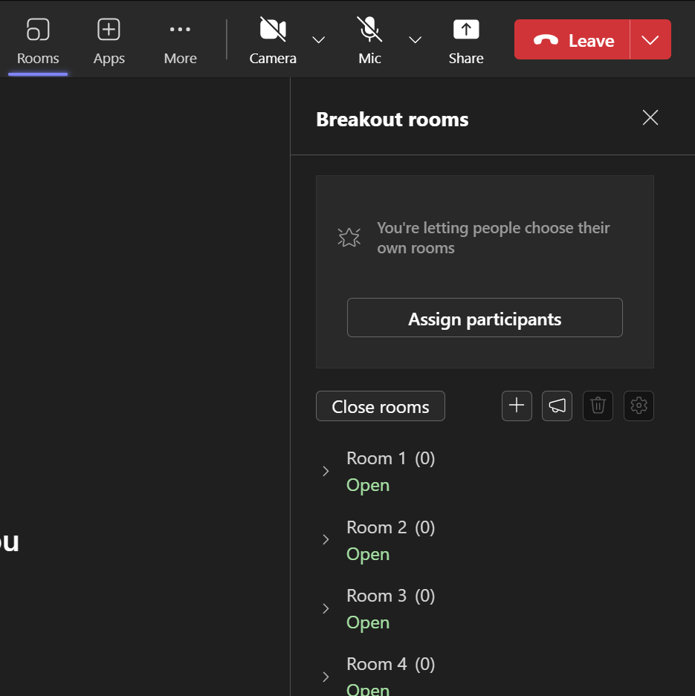
Breakout Rooms
Virtual participants will automatically be placed in a room with others (your team)
Team 1
Team 2
Team 3
Team 4
Notes:
Let’s talk a bit about the virtual participants. Virtual participants will automatically be placed in a breakout rooms with others and this will be your team. Teams should be about 8 people each. Team 1 is in room 1, team 2 is in room 2, etc.. The meeting facilitator will automatically do this, so don’t worry. I’ll let you know when this is going to happen. Keep an eye on the chat because there will be announcements for what the questions are and how much time is left.

Slide 8
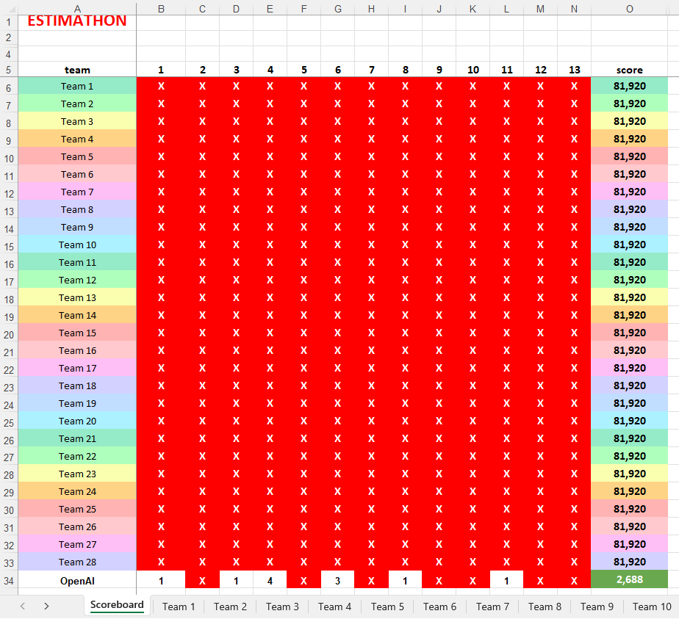

Data Entry
$$floor\left(\frac{\text{2_}\text{up}}{\text{2_}\text{low}}\right)$$
Scoreboard Tab
Team 1 Tab
5E+05
2,048,040,960
1
500000
1
Team
Name
Answer 1
Lower
Bound
Answer 1
Upper
Bound
Total Number
of
Submissions
for
Question 1
Answer 2
Lower
Bound
Answer 2
Upper
Bound
Total Number
of
Submissions
for
Question 2
Big score
Previous answers
are overwritten
Increment for each
new submission
Virtual participants must collectively enter the answers themselves in a shared Excel spreadsheet online (link will be shared in chat)
Data entry tabs for each team (only change the data for your team and no peeking!)
Notes:
So how do you submit your answers if you are playing online? In the chat someone is going to share a link to a shared Excel spreadsheet that you should open in your browser. I’m going to walk you through how to use this. The first tab is the Scoreboard tab and you don’t have to touch this. It’s going to automatically update whenever anyone enters a new answer. There is a separate scoresheet for everyone that is sitting in the auditorium. Both scoresheets will be shown on the screen during the contest. At the bottom, are tabs for each individual team. There isn’t any “protection” to prevent people from messing with other tabs, so please only work in your team’s tab and no peeking at the other ones. So let’s look at one of the Team tabs, like Team 1. It’s pretty straight forward and mirrors the answer slips that the people in person are going to be filling out. First is your team name. You all can pick a funny name and change it here. Next up are the answers for each problem, which are separated by vertical black lines. 1_low means the lower bound for your answer to problem 1, 1_up means the upper bound for your answer to problem 1, and 1_subs means you should keep track of how many times you submitted an answer for problem 1. This value you have to enter because there is no physical sheet of paper you are handing in like the in person people are going to have to do. So every time you want to do a new submission, please increment this number. Problem 2 is similar and there are 13 blocks just like this for each of the 13 questions. So for example, for problem 2 say you come up with an answer of 1 for the minimum value and 500000 for the maximum value. Then you would put them in the corresponding spots, and increment the number of submissions from 0 to 1.
Entering a very large range also puts a very large score on the scoreboard for problem 2 on Team 1. The scoreboard will update automatically with the entered answer which as a reminder is the upper bound divided by the lower bound rounded down, which here is 500000 divided by 1. As you can see, the corresponding score is very big because this is a really large interval. So you might consider redoing that problem to get a smaller or better interval. So if you want to resubmit, just overwrite your previous answer and increment the number of submissions.
Last thing you might notice at the very bottom of the scoreboard is the OpenAI team. I ran these questions through some AI models from OpenAI, Meta, Google, and Anthropic for fun. Hopefully you can get better scores than the AI.

Slide 9
Tips
Split up the questions
Use rough estimates that are easy to multiply or divide
Precision is rewarded more than accuracy
Exact Answer = 7
good interval = [2, 9] not-great interval = [1, 500000]
Notes:
Last thing I want to mention are some tips to keep in mind. First, you only have 30 minutes and 13 questions which is a little under 3 minutes per question. Try to split up the questions and divide and conquer so you have can try to answer all the questions in the limited time. When you do try to answer the questions, to help with the multiplying and dividing, it helps to pick numbers that are easy to work with, like powers of 10. Finally, precision is rewarded more than accuracy. Going back to our earlier example which had an exact answer of 7, a good answer to the question would have an interval that not only contains the answer (making it accurate) but also has high precision. The interval 2 to 9 is going to give you a significantly better score than the 1 to 500000 answer. Both are accurate, but stick with the more precise one. This is again because the score is determined by the ratio of the upper bound and the lower bound. If the numbers are roughly the same magnitude, then the ratio will be low, giving you a better score.

